Slide 1
Top Hat | UB Tech Town Hall
Thursday, October 26, 2023

Slide 2
Today’s Agenda
Top Hat Overview/Refresher
New AI Capability!
Platform Demonstration
Q&A

Slide 3
Top Hat Overview/Refresher
Active Learning, Anywhere
Notes:
Story 1

Slide 4
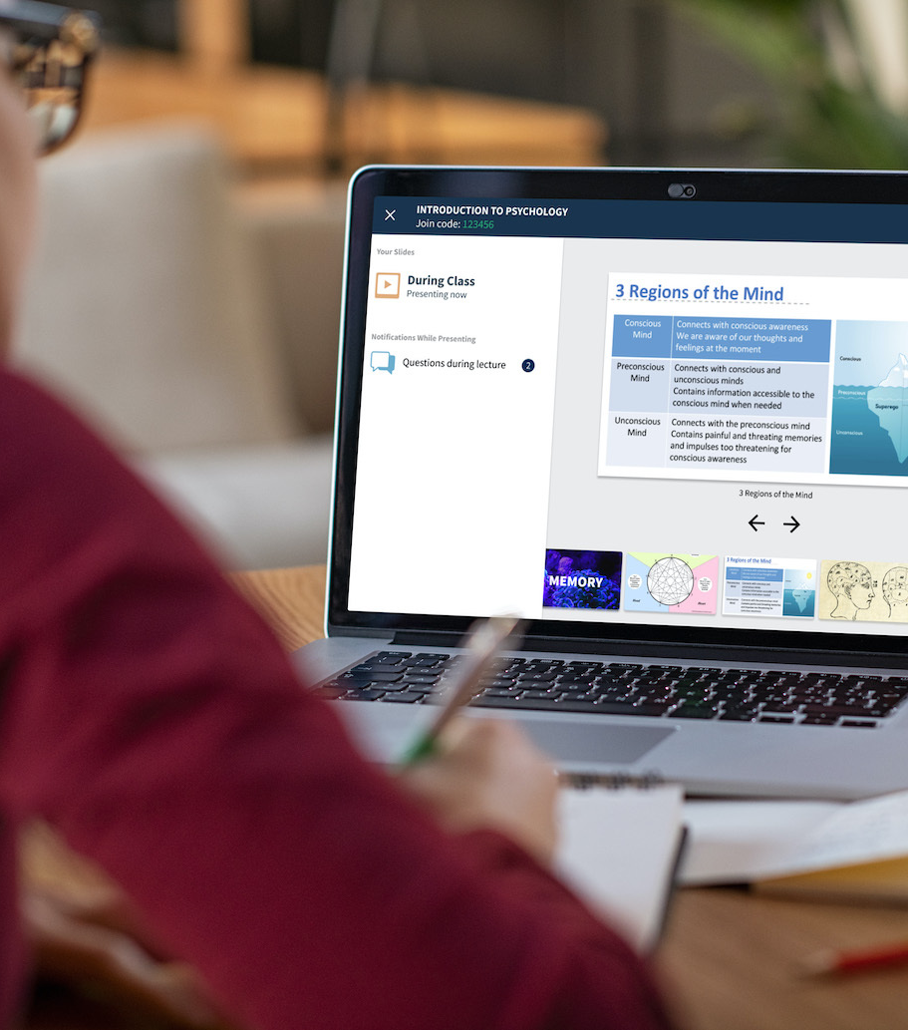
What is Top Hat? Top Hat’s active learning platform gives students a more engaging experience inside and outside the classroom with interactive content, participation tools and learning activities.
Notes:
Before we get started I do want to spend a minute introducing Top Hat to those of you who may not be familiar with what we do. top hat is an all-in-one teaching platform that enables Educators to facilitate Active Learning before during and after class. synchronously or asynchronously remote or in person, the top hat teaching platform enables you to create an engaging and Interactive Learning environment for you and your students.
Okay, so this is Top Hat, and you’ll get to know this software very well over the next few weeks, so what is Active Learning?

Slide 5
All-in-One Student Engagement Platform
OUTSIDE THE CLASSROOM
Feedback & Insights
Attendance
Assignments
Asynchronous
Tests & Exams
Discussions
Real-time actionable
insights
Labs
Tests & Exams
INSIDE THE CLASSROOM
Interactive Textbooks
Polls & Quizzes
Accessibility
Notes:
TANIA
Top Hat’s teaching and learning platform provides the flexibility instructors need to easily adapt course content and delivery methods, eliminating the cost and complexity of using multiple tools.
Engage diverse learners in and out of class with content that can be easily customized to meet course objectives and capture the needs and interests of today’s students. Video, interactive multimedia, and comprehension-based questions ensure students are engaged and on-track before they set foot inside the classroom.
Support student success with learning insights that go beyond basic letter grades. Every interaction—attendance, participation, assignments, tests—is tracked automatically, giving you the signals to course-correct and pinpoint students in need of extra support.
Built for students and faculty, Top Hat embraces the highest standards for accessibility and ease of use. Top Hat also uses proven approaches to scale adoption and teaching innovation, whether for individual faculty or your entire institution. One-to-one onboarding, instructional design expertise and project management support ensure faculty are equipped to deliver learning experiences that transform.
Top Hat is also committed to reducing student costs by combining high-quality content with the power of Top Hat’s teaching and learning platform. Deliver superior learning experiences by customizing OER content or empowering faculty with the tools to create their own interactive course materials.

Slide 6
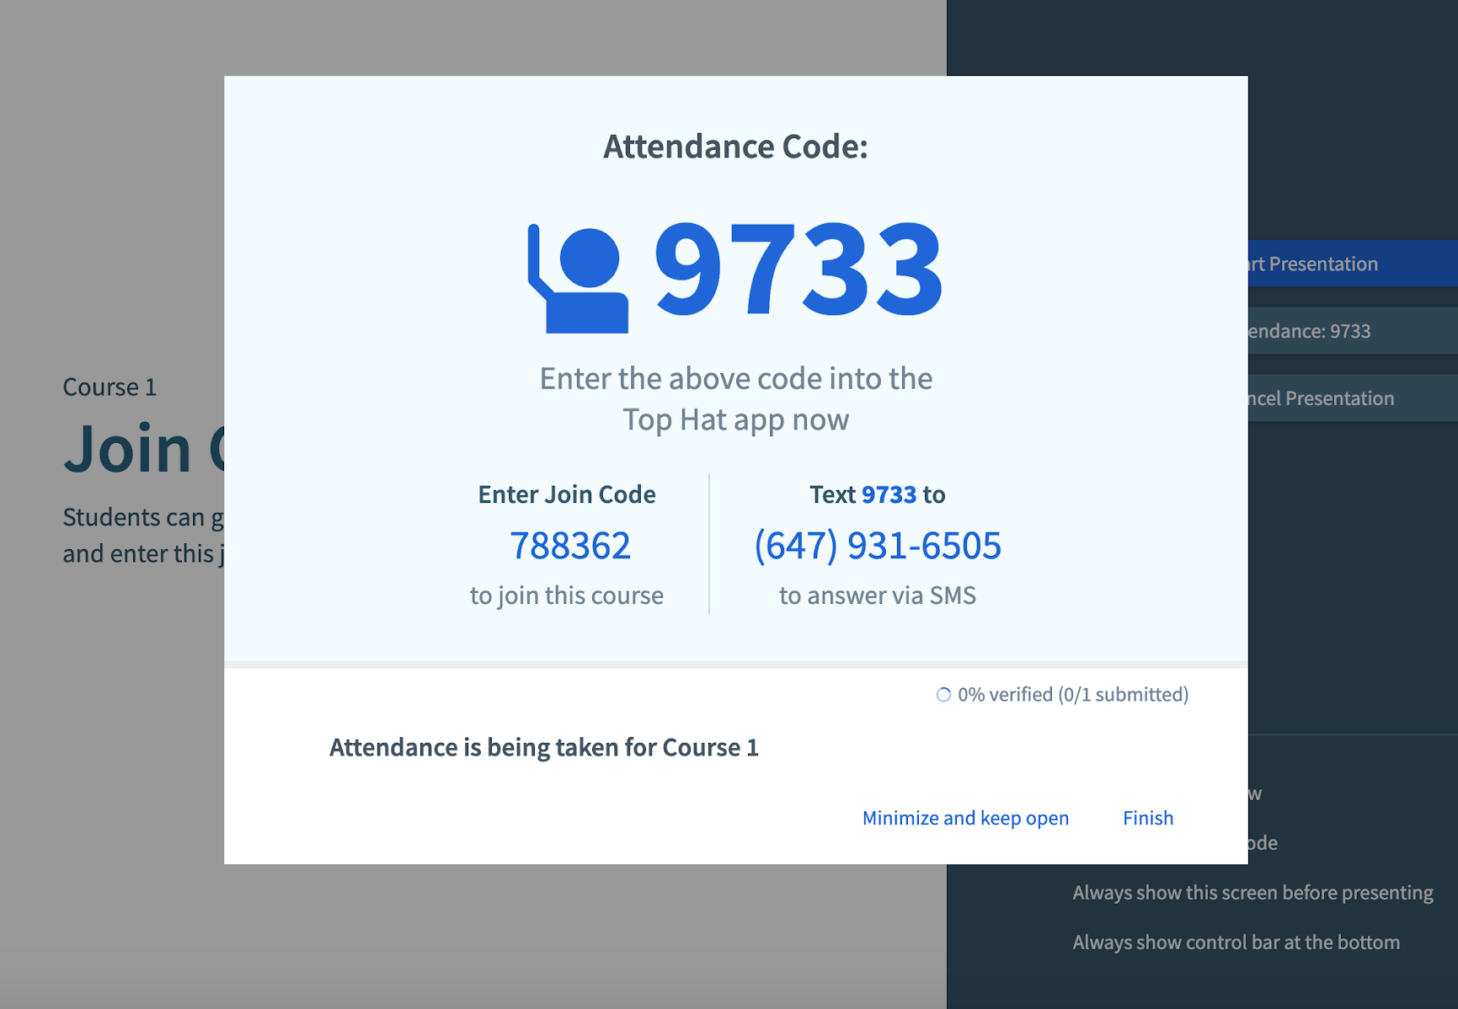
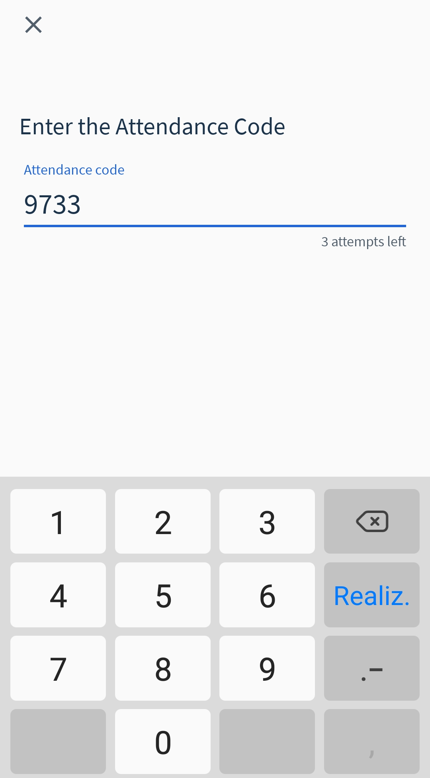
Take Attendance
Students mark themselves present with their phone, tablet or computer using a unique 4 digit code.
‹#›

Slide 7
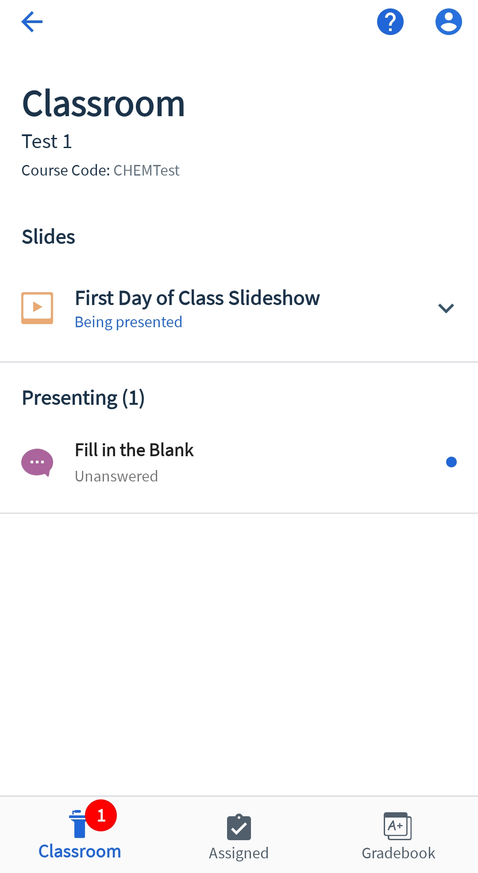
Run Polls & Quizzes in Class
Answer live questions and polls from any device throughout class presentations.
‹#›

Slide 8
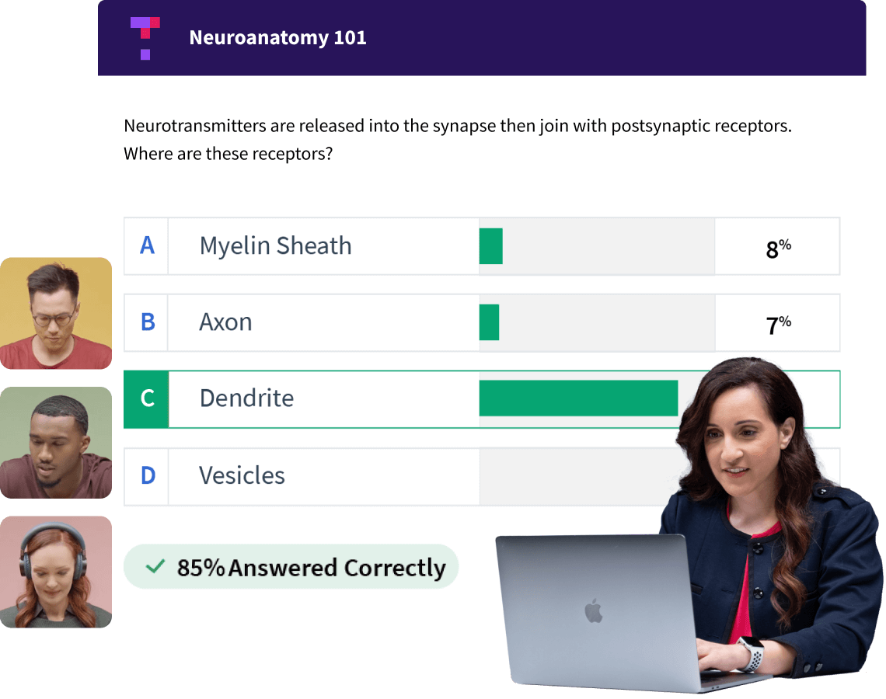
Top Hat is a Student Learning Platform
‹#›

Slide 9
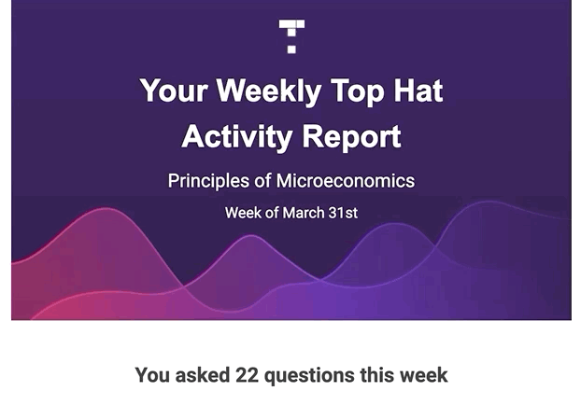
Gain Quantifiable Insight into Comprehension

Slide 10
Customizable Interactive Courseware
Flexible content solutions to teach your course, your way
Intuitive Authoring Tools
Easily create content and make it immediately available to students.
Customizable Textbooks
High quality interactive texts easily customized to meet course objectives.
OER Optimization
Incorporate and optimize low or no-cost OER course material.
Notes:
NP

Slide 11
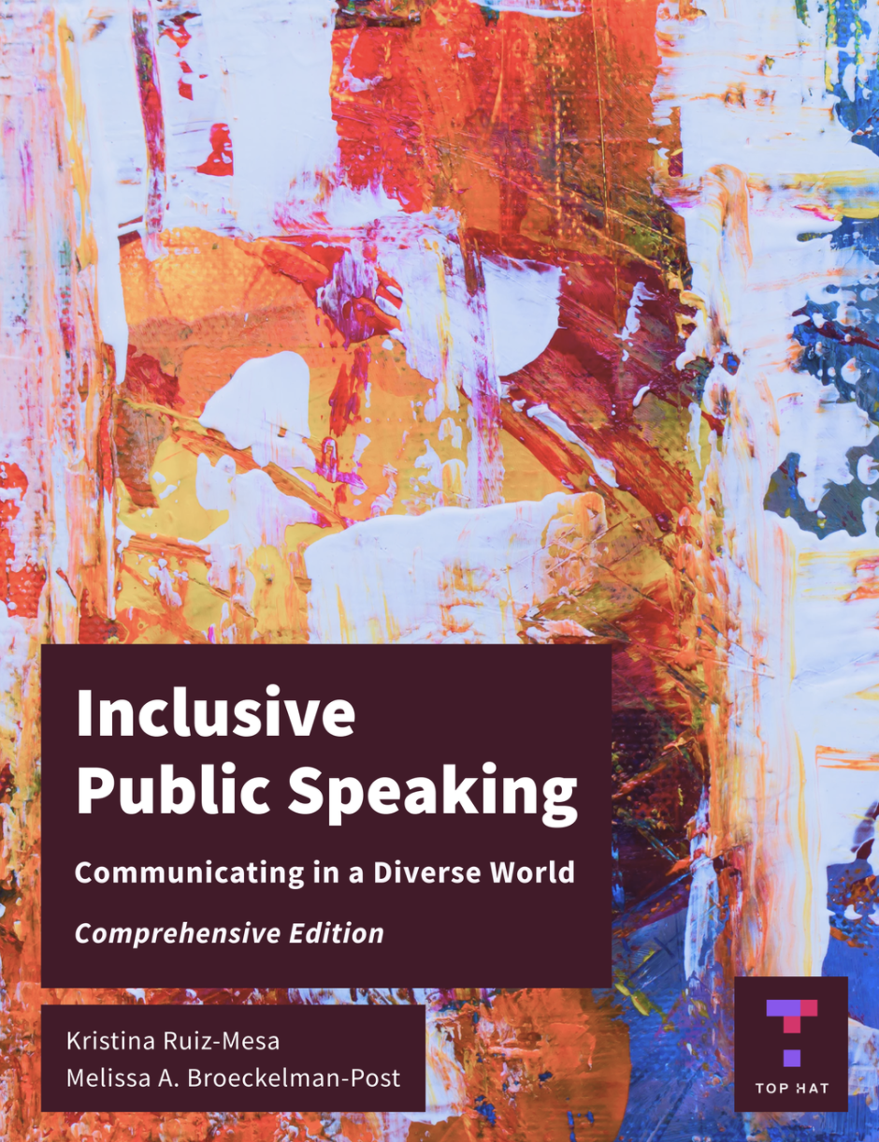
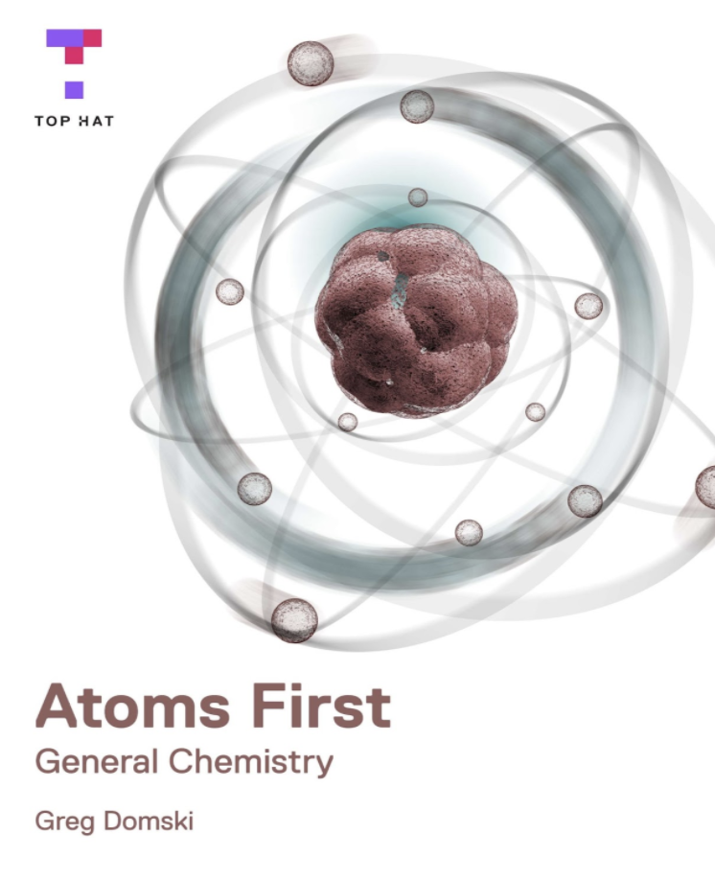
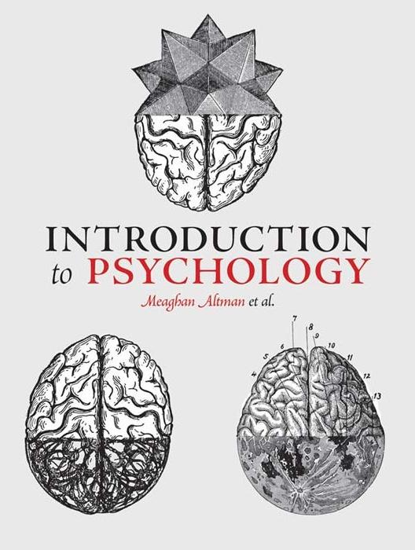
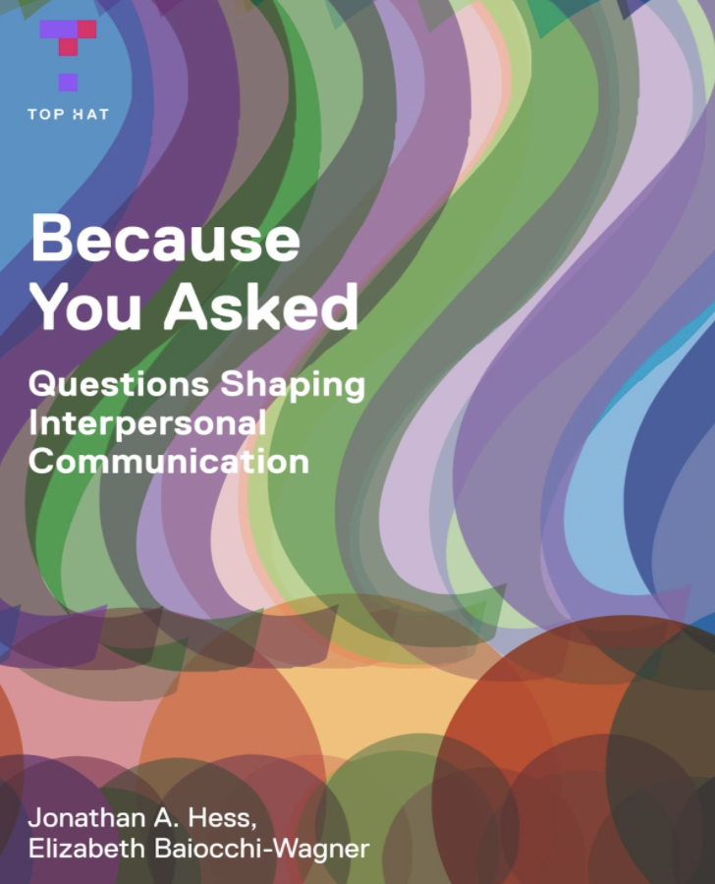
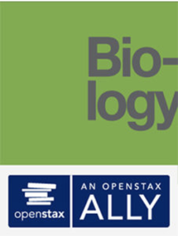
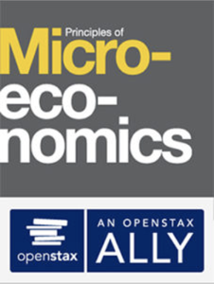
Interactive Textbooks/OERs & Lab Manuals
Customize and optimize existing OER course material. Leverage AI technology!

Slide 12
Platform Demonstration
Active Learning, Anywhere
Notes:
Story 1

Slide 13
Implementation - Support & Accessibility
Active Learning, Anywhere
Notes:
Story 1

Slide 14
LTI 1.3 Integration
Top Hat integrates with Brightspace to support AU faculty in delivering improved learner outcomes
Instructor
Active Learning Platform
LMS
ENGAGING
CLASSES
INTERACTIVE READINGS
ACTIONABLE
INSIGHTS
BUILT-IN ASSESSMENTS
REMOTE
TESTS
Notes:
Our Top Hat platform, now Top Hat Pro, is the same active learning platform faculty and students already know and love but now with full virtual classroom capabilities (including native video conferencing directly within the Top Hat platform) PLUS content PLUS remote proctoring PLUS best-in-class support to help faculty quickly transition their courses online.
Top Hat seamlessly integrates with your LMS. With Top Hat, you can turbocharge your LMS to drive more student engagement and create stronger active learning experiences. With our classroom engagement features, interactive readings, range of formative and summative assessments, and remote testing capabilities, Top Hat has all the tools your faculty need to run their course, all in one place.

Slide 15
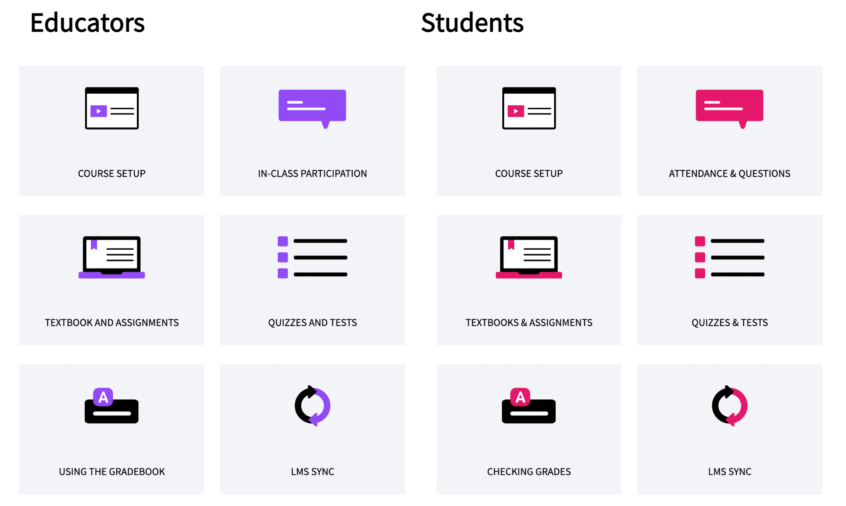
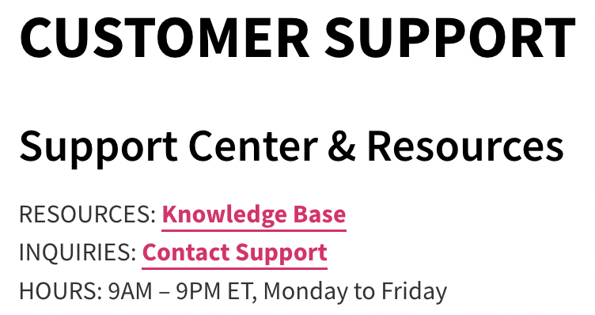
Top Hat Support
Every AU professor is assigned an Instructional Designer and Customer Success Manager for consistent support
Notes:
Our Top Hat platform, now Top Hat Pro, is the same active learning platform faculty and students already know and love but now with full virtual classroom capabilities (including native video conferencing directly within the Top Hat platform) PLUS content PLUS remote proctoring PLUS best-in-class support to help faculty quickly transition their courses online.
Top Hat seamlessly integrates with your LMS. With Top Hat, you can turbocharge your LMS to drive more student engagement and create stronger active learning experiences. With our classroom engagement features, interactive readings, range of formative and summative assessments, and remote testing capabilities, Top Hat has all the tools your faculty need to run their course, all in one place.

Slide 16
Let me know if you want to learn more!
Active Learning, Anywhere
Notes:
Story 1

Slide 17
Today’s Walkthrough
Personalized Demonstration/Follow up Call
Active Learning
Start Increasing Engagement with Top Hat!
Get set up with our Instructional Design Team
Next Steps!
Notes:
Active learning is at the centre of our training services program. This program will help get your faculty prepared and comfortable with transitioning their courses online, and it is designed in line with 4 pillars:
Scholar-led, evidence based -- We promote an evidence-based approach to teaching by focusing on research-backed principles of learning and proven strategies of success.
Scalable -- With our support team as well as our “train-the-trainer” approach, we will work with you to scale active learning at your institution and ensure your faculty are equipped with the knowledge they need to get full use of the Top Hat platform.
Community -- Learning doesn’t happen in a vacuum, and neither should training. We understand the importance of community to your faculty, and will work with them to build and share knowledge, and create an active learning community at your institution.
Insights-Driven -- Throughout our partnership, as we help you reach more instructors with our instructional design and training support services, we will report on faculty attendance, satisfaction and usage of the Top Hat platform.

Slide 18
Q&A
‹#›

